Slide 1


effectiveness of the friendship sale promotion
VYOM BHATT

Slide 2
Presentation Content
Topics
Objective
Data Overview
Data Preparation
EDA Insights Snapshot
Friendship Sale Promo Insights
Friendship Sale Promo Campaign Impact
Model Building and Evaluation
Summary
Assumptions & Limitations

Slide 3
Objective
The objective at hand is
to assess the effectiveness and the impact of the Friendship Sale Promo Campaign that ran online during March 2020 (21st to 23rd March)

Slide 4

Data Overview
Order Master Dataset
This table has includes data pertaining to all the orders that have been generated between Jan 2018 to July 2019.
Total Rows: ~10M Total Columns: 26
Promo Master Dataset
This table has includes data pertaining to all the promos that were used for all the orders in the same time period..
Total Rows: ~3M Total Columns: 11
The data cleaning, preparation, exploratory analysis and model building insights that follow have been designed particularly in order to answer the primary problem statement i.e. the effectiveness of the Friendship Sale Promo during March 2020

Slide 5
Data Preparation
1
2
3
The order_num is not distinct. There are several iterations of the same order present.
We consider the greatest order_lin_no value for each order_num and eliminate the rest to ensure de-duplication of the primary key
Treating the missing values in the orders table:
Dropping cols with over 80% nulls
mean/median/mode/zero imputation
Imputation based on other relevant columns
- Identifying distinct promo codes per order from the promo table.
- Creating a separate column for each promo code in the orders table and assigning it 0 or 1
- This leaves us with a single master table capturing both the orders and promo data
4
5
6
Deriving New Features that maybe of relevance:
Temporal Components from timestamp
Revenue per Unit
Total Coupons used per Order
Coupon Usage Rate
Coupon Revenue Generation Rate
Treating anomalies in the dataset:
Outlier treatment
Eliminating categorical variables that are massively skewed to just 1 category, hence not explaining enough variance within them
Eliminating variables not relevant from a modeling and business perspective
Encoding all the different categorical variables using appropriate techniques:
One-hot encoding
Cyclic encoding for temporal components
Target encoding for HCCV’s

Slide 6
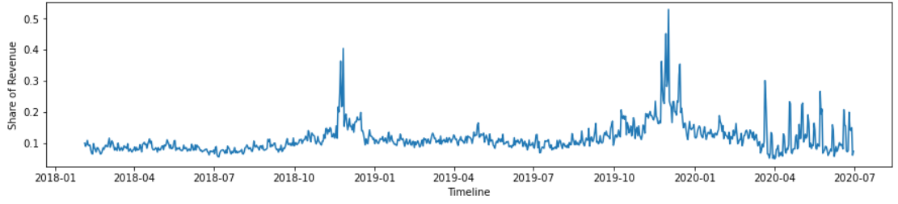
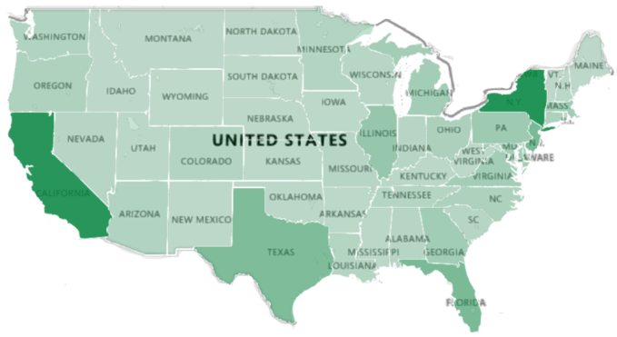
EDA Insights Snapshot
The insight below give an overall idea of the what the data represents and what the purchase patterns of users are.
*The data considers all the orders that have been recorded.
On observing the data, we clearly see a seasonal pattern, with sales increasing during the holiday periods of Nov/Dec
Country with greatest sales both in terms of volume and revenue
New York and California were the states that generated the greatest revenue
Revenue generated by coupon codes
Coupon Code | Revenue Share
PC_ECOM_CD_1 | 42.7%
PC_ECOM_CD_2 | 37.8%
PC_ECOM_CD_3 | 3.0%
PC_ECOM_CD_4 | 2.7%
PC_ECOM_CD_5 | 2.6%
PC_ECOM_CD_6 | 2.0%
PC_ECOM_CD_7 | 1.8%
US
(>95% revenue)

Slide 7
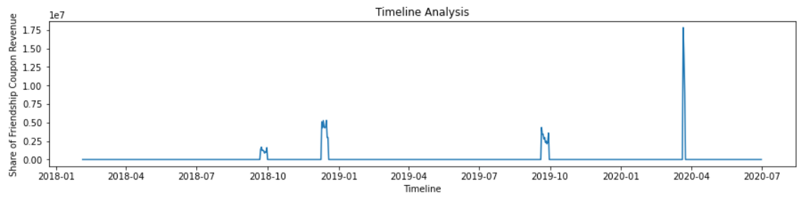


Friendship Sale Promo Insights
Having understood what the data is talking about, let’s delve into the Friendship Sale Promo Code Insights, which is our primary focus.
From the timeline, we observe that the friendship coupon over the years was used during only certain portions of the timeline. The greatest share of revenue generated, however, was the burst of March 2020.
Since we’re mainly concerned with the impact that the Friendship Promo Code had for the month of March 2020, we’ll isolate the March data points for this promo code and create a separate variable for this.
In order to compare the effectiveness of the promo code, 2 new metrics have been designed:
$$Revenue Generation Rate=\frac{Total Sales}{Promo Period}$$
$$Coupon Usage Rate=\frac{Total Coupons Used}{Promo Period}$$

Slide 8
Friendship Sale Promo Impact
Measuring Impact vs. other Coupon Codes
Measuring Impact vs. Baseline Sales
$$Incremental Sales Uplift=\frac{New Sales −Baseline Sales}{Baseline Sales}$$
Where:
New Sales: Revenue Generation Rate for the Friendship Promo Campaign
Baseline Sales: Revenue Generation Rate without use of coupons
The Incremental Uplift for the Friendship Sale Promo Campaign was:
235%
We are able to quantify that the Friendship Sale Promo Code was indeed very effective during March 2020!

Slide 9
Model Building and Evaluation
The next phase involved building a regression model on the order level features to identify the levers that contribute most significantly to sales.
The table below evaluates the performances of the different regression models on the test set:
Regression Model | R-Squared | MAE
Linear Regression (with RFE) | 0.343 | 873.959
Ridge Regression | 0.343 | 873.962
Lasso Regression | 0.343 | 874.02
Decision Tree Regression | 0.404 | 773.61
Random Forest Regression
NOT ENOUGH COMPUTE POWER TO COMPLETE TRAINING!!
* With over 4M rows and close to 26 columns (that increase to >60 after encoding, the compute power of my system was not enough to train the models well. As a result, implementation of neural networks, SGD regressor, and other ensembles like gradient boosting algorithms were not implemented.

Slide 10
Summary
- The Decision Tree model was the best performing model out of all that were tested
When looking at the feature importance of the Decision Tree, the Friendship Promo Code is the 7th best performing Coupon Code when compared to all the other Coupon Codes
From the EDA, we were able to successfully quantify the impact that the Friendship Promo Code had on Sales.
The Friendship Promo Code was the 2nd best Promo Code in terms of the Coupon Usage Rate and the Revenue Generation Rate
The Friendship Promo Code resulted in a 235% incremental sales uplift when compared to the baseline sales.

Slide 11


Assumptions & Limitations
Assumptions
The revenue is only dependent on the features that we have been provided with in the dataset, and nothing externally
We’ve assumed that the latest entry under the ord_lin_no corresponds to the most updated entry of the order_num, hence we were able to deduplicate the order_num
Limitation
Computational Resources
Duration Available

Slide 12
Thank You

